Slide 1

Word search using openmp
Vinod B-19BCE1574

Slide 2
Abstract:
The motivation of this project is to use parallel processing in a different fields of computing. One such field I have selected is word searching.
I am implementing word search algorithm to search a word from different files.
I am also comparing the series time with the parallel timings in word searching and concluded the results
I search a file with the target word and say if it is present in a particular file or not

Slide 3
Types of Text Search Engines
Finding and selecting full or partial content based on the keywords provided.
Maintaining index of the content and referencing to the location they find
Allowing users to look for words or combinations of words found in that index.

Slide 4
Concept
We first do frequency mapping and then do the parallel computation of the word
OpenMP is a set of compiler directives as well as an API for programs written in C, C++, or FORTRAN that provides support for parallel programming in shared-memory environments. OpenMP identifies parallel regions as blocks of code that may run in parallel.
Since the work is recursive and pattern is same we can split into various parts so that we can reach the result in less time.

Slide 5
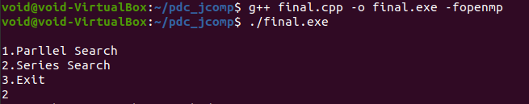
Important part of Code explanation:

Slide 6
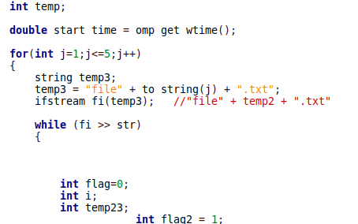
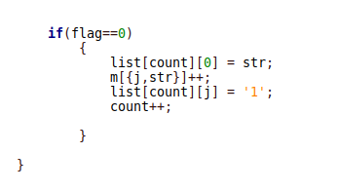
Series code

Slide 7
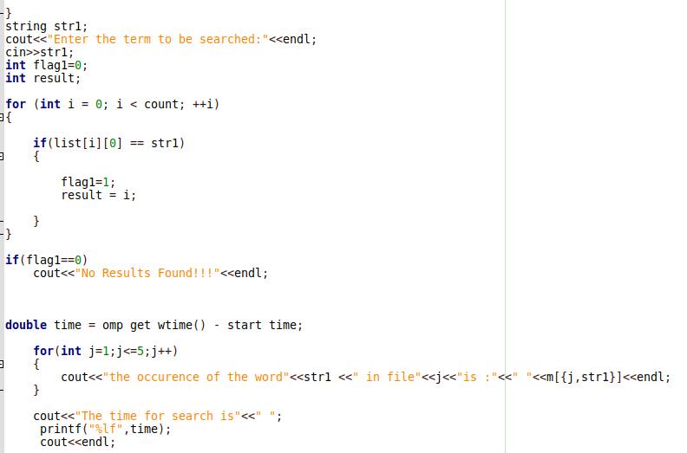

Slide 8
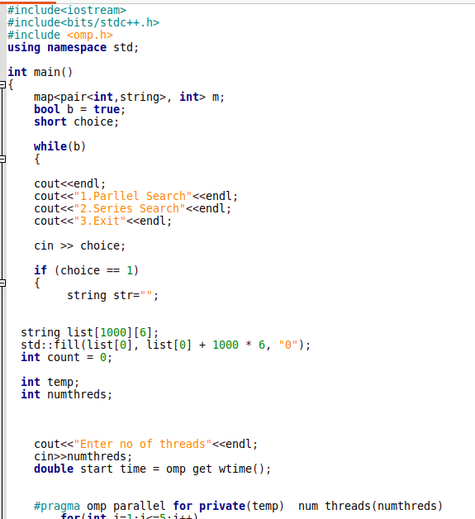
Parallel

Slide 9
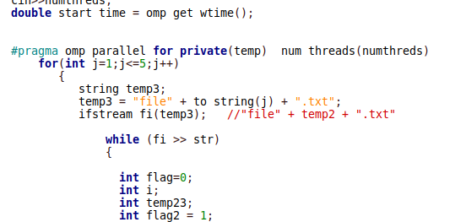

Slide 10
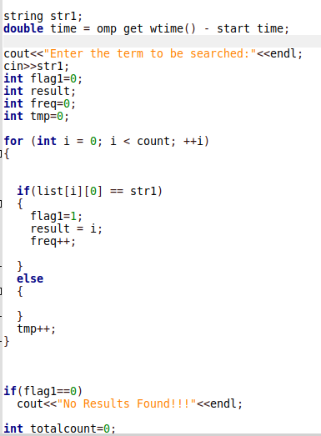

Slide 11
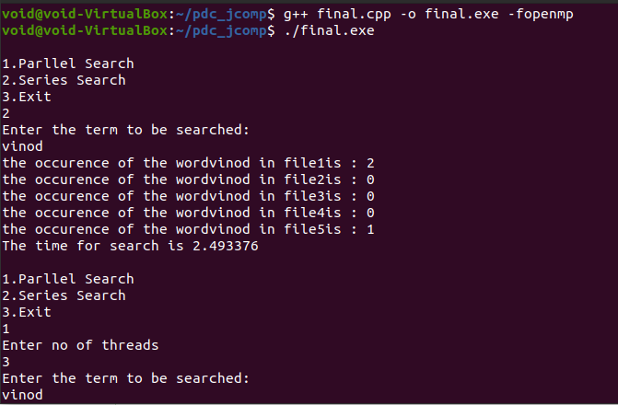
OUTPUT:

Slide 12
